Slide 1

Introduction to the FPSLREB’s E-Docs Portal

Slide 2
As part of the modernization of its information management processes, the Federal Public Sector Labour Relations and Employment Board (FPSLREB) has developed an eDocs Portal to facilitate the exchange of information for its processes.
The eDocs Portal allows you to share large documents without having to split them into multiple submissions and to share electronic documents in real time during a hearing.
Introduction to the FPSLREB’s e-docs portal

Slide 3
REGISTER TO THE e-Docs Portal
To register, click on the link below and select your language of choice:
https://edocsportal-portaildoc.fpslreb-crtespf.gc.ca/
e-docs portal
Registration process

Slide 4
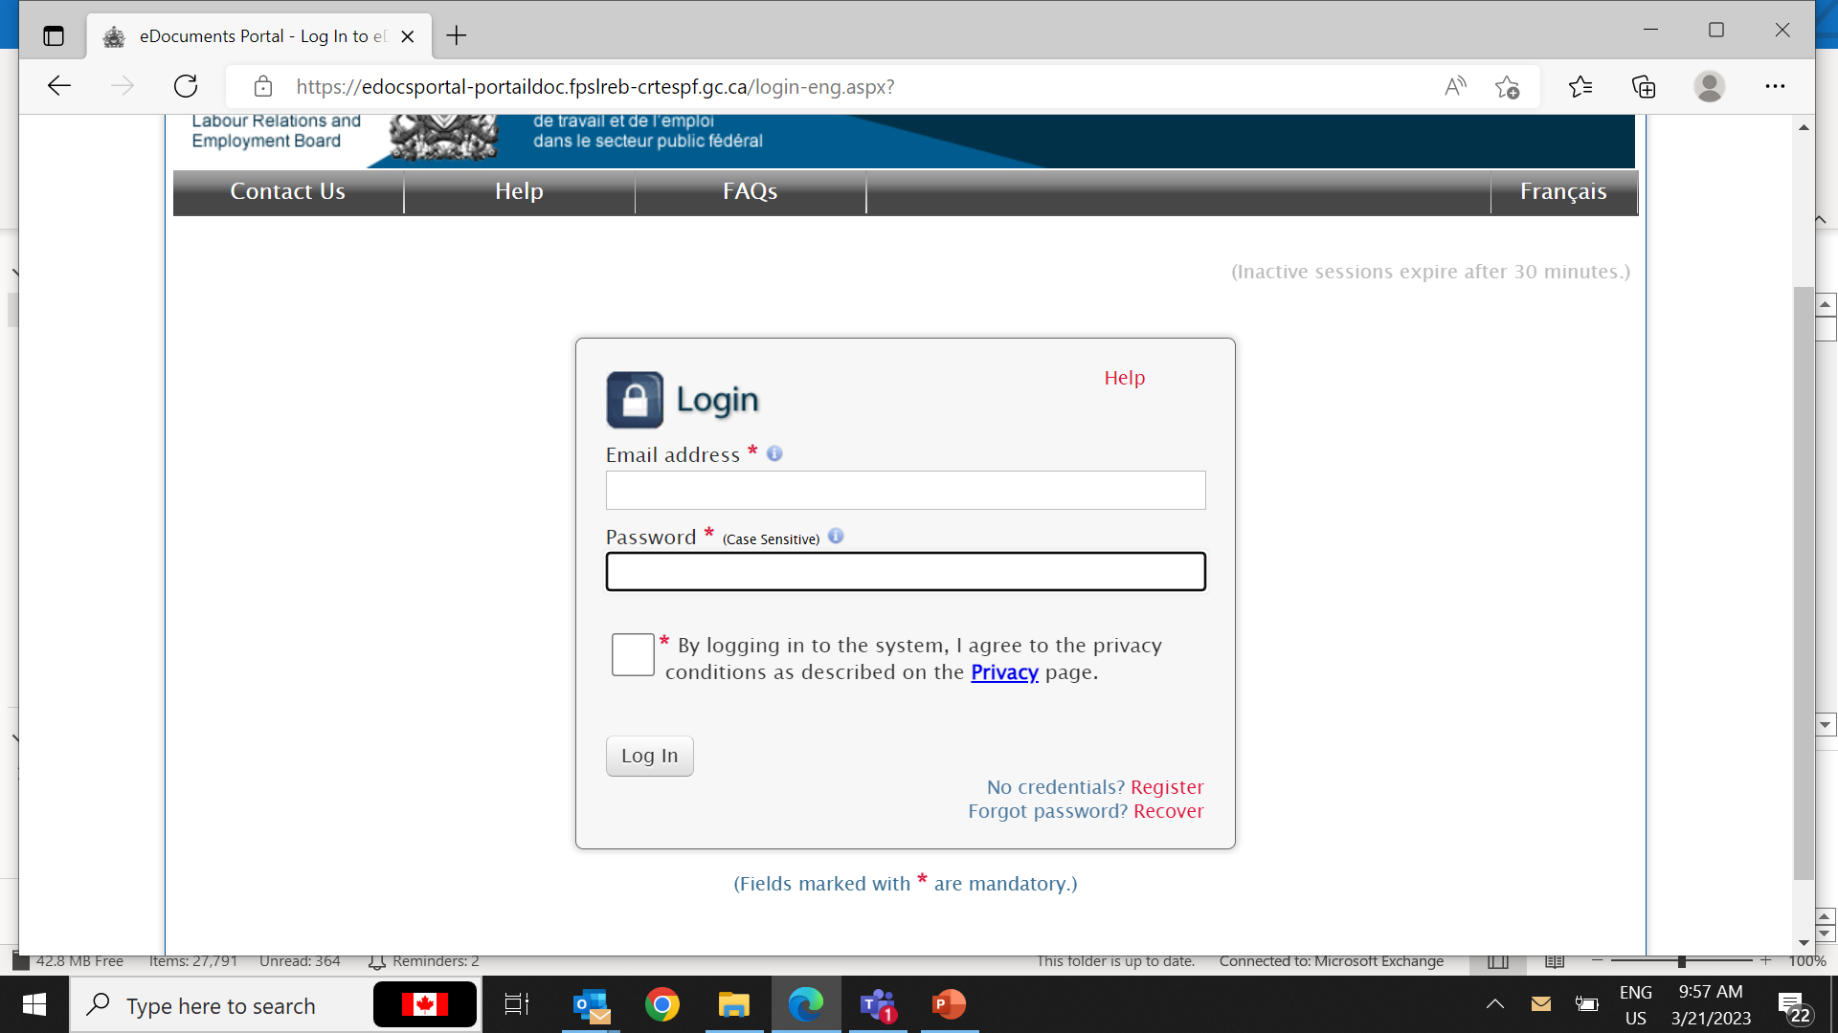
REGISTER TO THE e-Docs Portal (continued)
LOGIN PAGE
Once at the Login Page, click on Register
e-docs portal
Registration process
Note: The registration process is done only once. If you are already registered, go to slide 9.

Slide 5
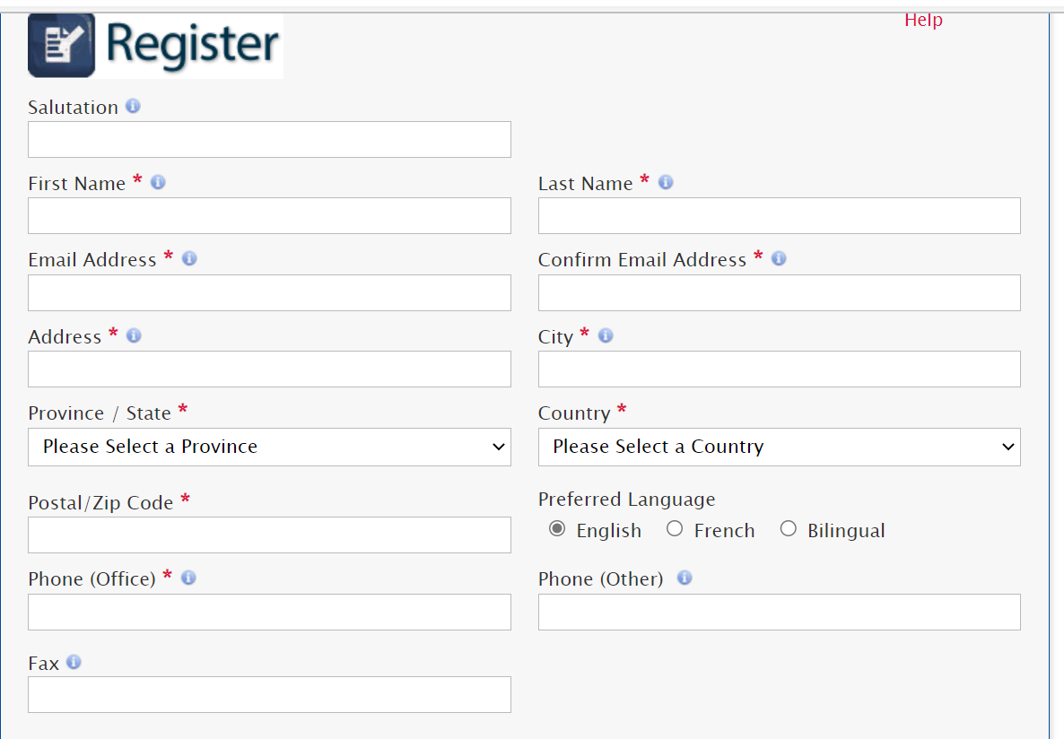
REGISTER TO THE e-Docs Portal (continued)
Complete the mandatory fields marked by red asterisks.
e-docs portal
Registration Process

Slide 6
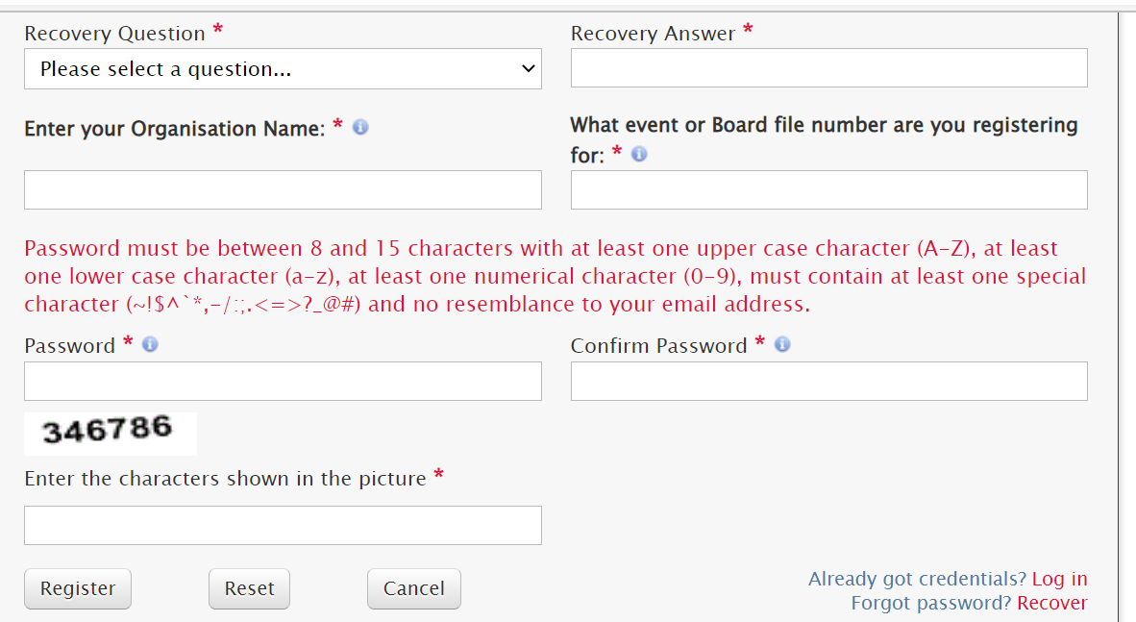
REGISTER TO THE e-Docs Portal (continued)
Complete the mandatory fields marked by red asterisks.
Click on Register once all the information is completed.
e-docs portal
Registration process

Slide 7
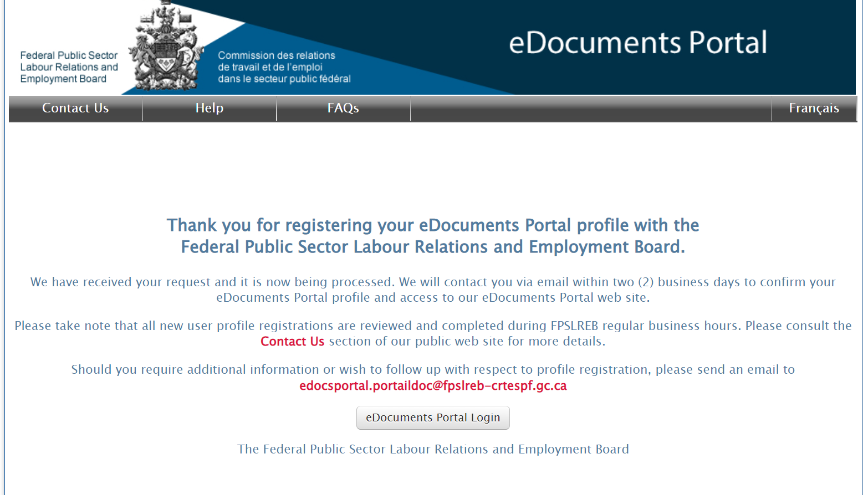
REGISTER TO THE e-Docs Portal (continued)
CONFIRMATION PAGE
A confirmation page informing you that the registration request in being processed will be displayed and an e-mail will be sent to you.
e-docs portal
Registration process

Slide 8
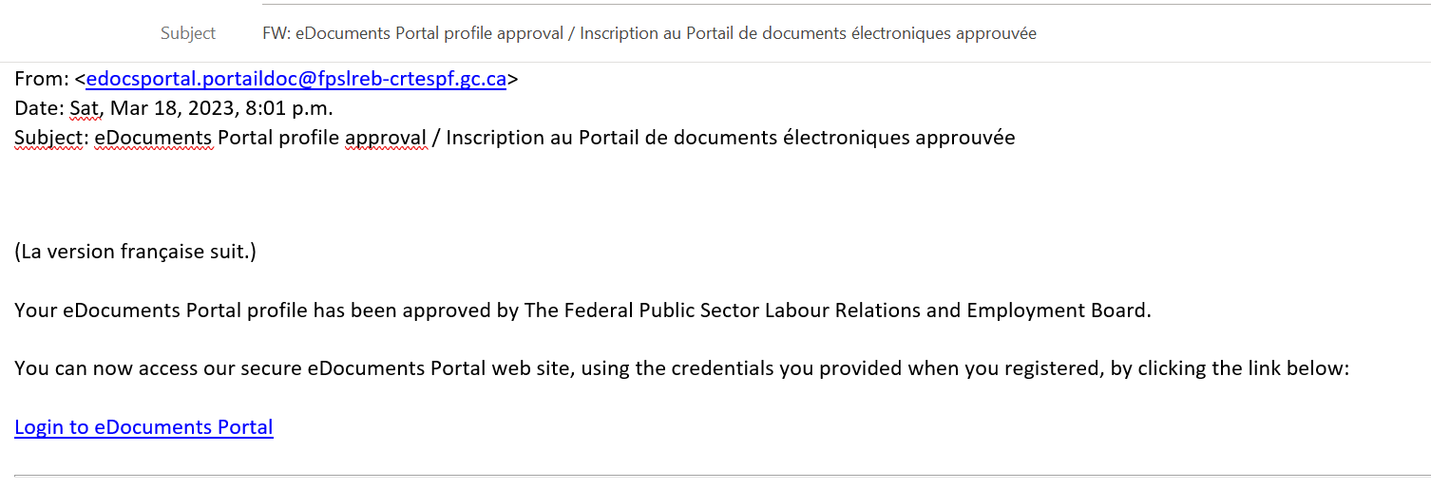
REGISTER TO THE e-Docs Portal (continued)
CONFIRMATION EMAIL
Once your registration is processed, you will be notified by e-mail (see below), and you will have full access to the e-Documents Portal.
You can now login and begin uploading documents.
e-docs portal
Registration process

Slide 9

How to upload Documents
You can submit documents by clicking the “UPLOAD documents” button on the eDocuments Portal home page.
e-docs portal
Document upload
Note:
Support can be provided during regular business hours, Monday to Friday from 8:00 a.m. to 4:00 p.m. (Eastern Time) except statutory holidays. You can contact us at edocsportal.portaildoc@fpslreb-crtespf.gc.ca
Documents received will only be processed during regular business hours, Monday to Friday from 8:00 a.m. to 4:00 p.m. (Eastern Time) except statutory holidays.

Slide 10
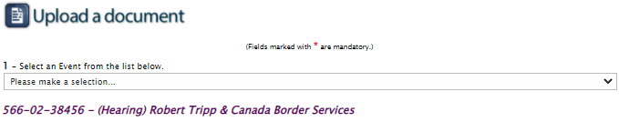
How to upload Documents (continued)
Select the Event for which you wish to upload documents.
e-docs portal
Document upload

Slide 11
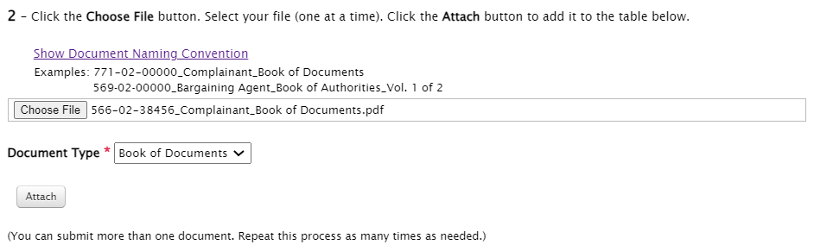
How to UPLOAD Documents (continued)
Click on Choose File to browse through the files you wish to submit - select your files one at a time.
Select the appropriate Document Type from the drop down menu
Click on Attach.
e-docs portal
Document upload

Slide 12
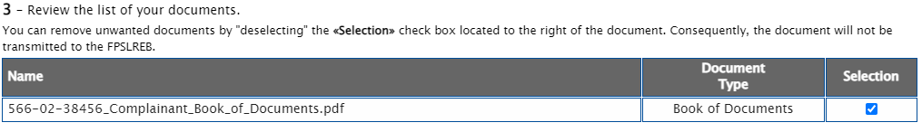
How to UPLOAD Documents (continued)
Review the list of your documents.
You can remove unwanted documents by “deselecting” the “Selection” check box located to the right of the document.
e-docs portal
Document upload

Slide 13
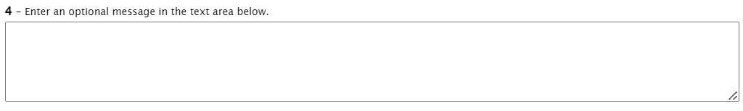
HOW TO UPLOAD DOCUMENTS (continued)
A content box is provided to enter a message, should you deem it necessary.
Entering a message is optional.
e-docs portal
Document upload

Slide 14
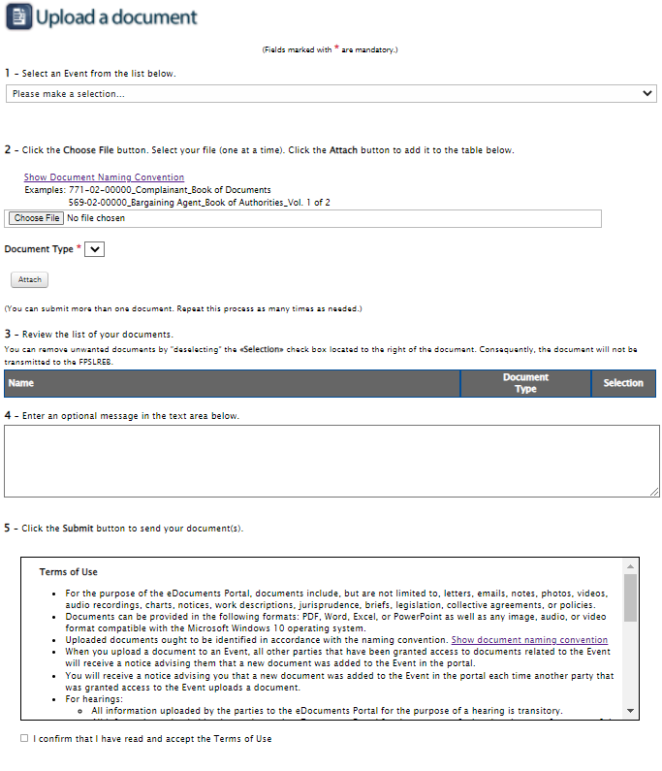
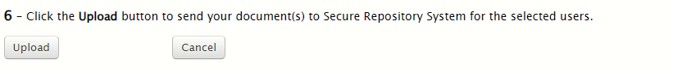
How to UPLOAD Documents (continued)
Check the box confirming that you have read the Terms of use.
Click Upload to upload your document(s) to the e-Docs Portal.
e-docs portal
Document upload
Note: If you click the “Cancel” button on the “Upload a Document” page, all information entered on this page will be erased and you will return to your eDocuments Portal main page.

Slide 15
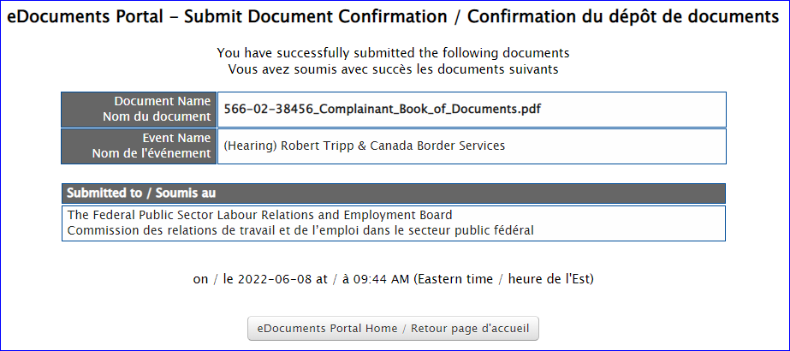
How to UPLOAD Documents (continued)
CONFIRMATION PAGE
Once your document(s) are uploaded, a confirmation page listing the uploaded documents will be displayed, along with the date and time of your submission.
e-docs portal
Document upload

Slide 16
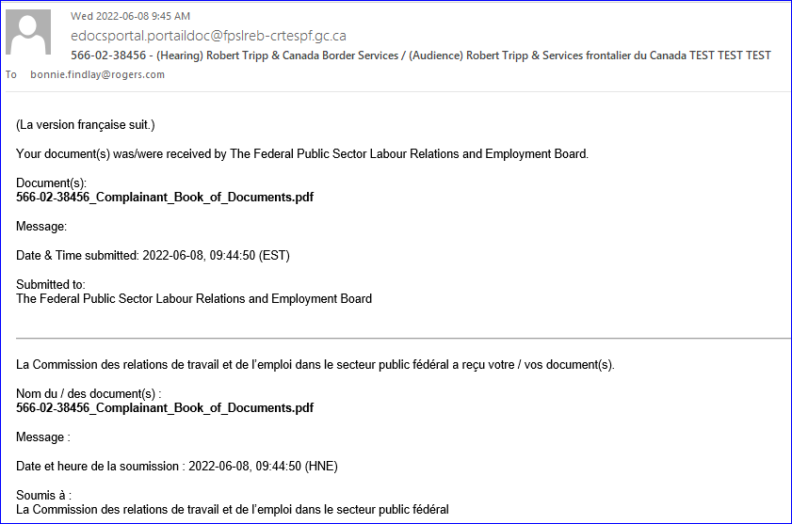
How to UPLOAD Documents (continued)
CONFIRMATION email
A confirmation email will be sent to you once the documents have been received.
e-docs portal
Document upload

Slide 17
How to Retrieve Documents
RETRIEVE documents
This function allows registered users to retrieve documents submitted by the parties of an event in which they are participating.
Only users who have an approved registered profile and have been associated to a specific event can retrieve documents.
e-docs portal
How to retrieve a document
Access rights are assigned to users on an event-by-event basis
Note: The list that will appear on the screen contains all the documents for all events. However, you will only have access to the documents associated with your event.
Notes:
Je ne comprends pas ta note dans le bas de la diapo

Slide 18
How to Retrieve Documents (continued)
An email notification is sent whenever a document is available for retrieval (see below).
e-docs portal
How to retrieve a document
From: <edocsportal.portaildoc@fpslreb-crtespf.gc.ca> Date: Sun, Mar 19, 2023, 12:44 p.m. Subject: 12345 - (Hearing) UAT Testing / (Audience) Test UAT
(La version française suit.)
Federal Public Sector Labour Relations and Employment Board has made available the following documents in the eDocuments Portal:
Document(s):
Doc1.docx (Book of Documents)
Date & Time published: 2023-03-19, 12:44:17 (EST)
Message:
Connect to the eDocuments Portal system to retrieve the documents.

Slide 19
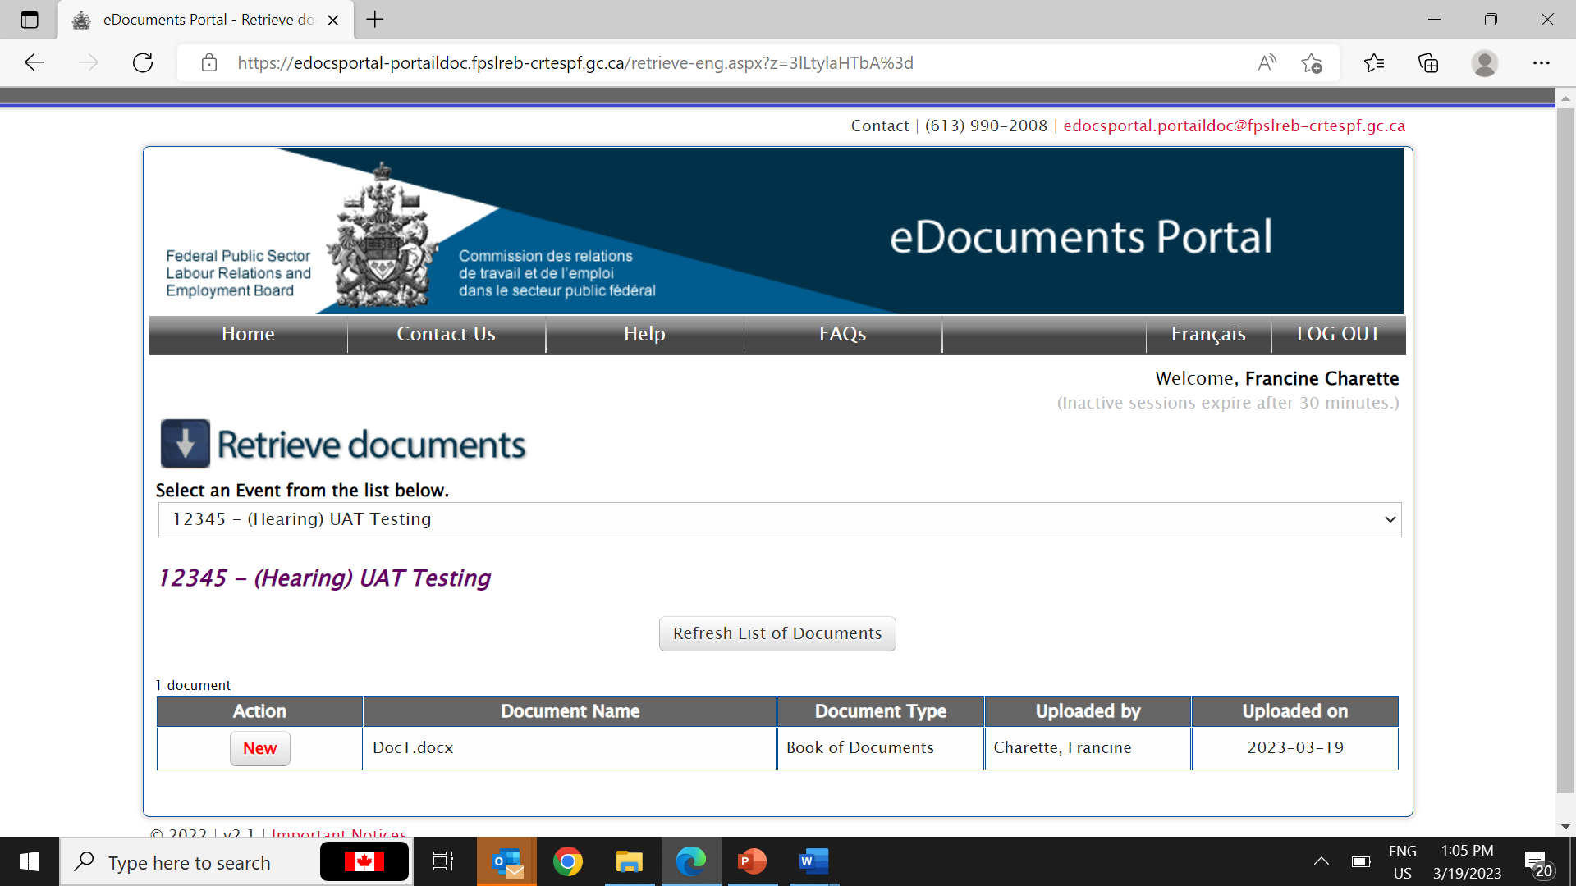
How to Retrieve Documents (continued)
Click on RETRIEVE documents to retrieve documents.
e-docs portal
How to retrieve a document
Select the Event for which you wish to retrieve documents
Select the document(s) to retrieve.

Slide 20
How to Retrieve Documents (continued)
How to view documents
To view a document the first time, click the “New” button located on the left side of the document name.
e-docs portal
How to retrieve a document

Slide 21
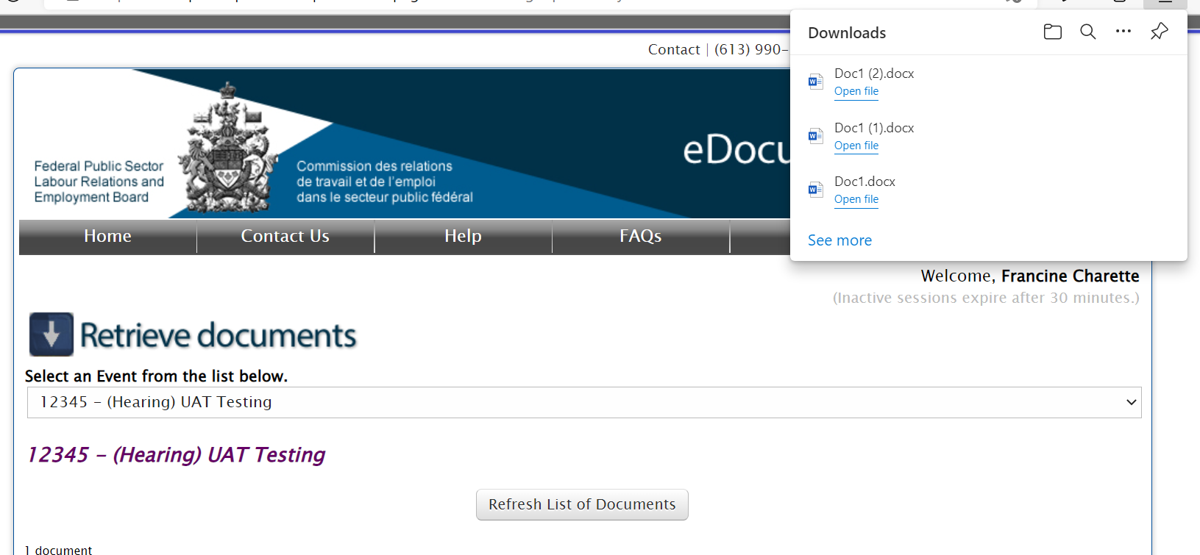
How to View Documents (continued)
The document will appear either on the top right corner or on the bottom left-hand side of your computer screen, depending on which system you are using. Click on the document to open it.
e-docs portal
How to retrieve a document

Slide 22

How to Retrieve Documents (continued)
How to RETRIEVE PREVIOULSY OPENED Documents
Click the Retrieved button located on the left side of the document name.
Refer to the “New” steps on the previous slide to view and download the document.
e-docs portal
How to retrieve a document
For troubleshooting, please contact us at
edocsportal.portaildoc@fpslreb-crtespf.gc.ca

Slide 23
END OF PRESENTATION
e-docs portal
Contact us
For troubleshooting, please contact us at
edocsportal.portaildoc@fpslreb-crtespf.gc.ca

